Slide 1
Code Mastery: Do You Really Need That SPA? Lou R. Houlemarde
August 1, 2017
Notes:
If your system doesn’t have the CORDIA NEW font, please use “Title Slide (Alt)”

Slide 2
Agenda
About Me
Lead Consultant with Magenic with nearly 20 years professional programming experience
Microsoft technologies since VB6 and ASP to C# and .Net Core
Business experience (practical solutions and bottom lines…)
Single Page Applications…
What are they and key capabilities
The flip side: complexity, learning curves, development time, costs
When it makes sense to revisit some solid Microsoft alternatives
Q/A
Contact

Slide 3
Code Mastery…
Mastering what code solutions work best for the business
Mastering development tools & technologies
Mastering languages and the general practice of coding

Slide 4



Single Page Applications
SPA Frameworks
Large client-side libraries w/ server-side build process (Node.JS)
Allow cleaner separation of code & data (M-V-VM)
Abstract the DOM and remove direct manipulation
And of course… no page refreshes!

Slide 5
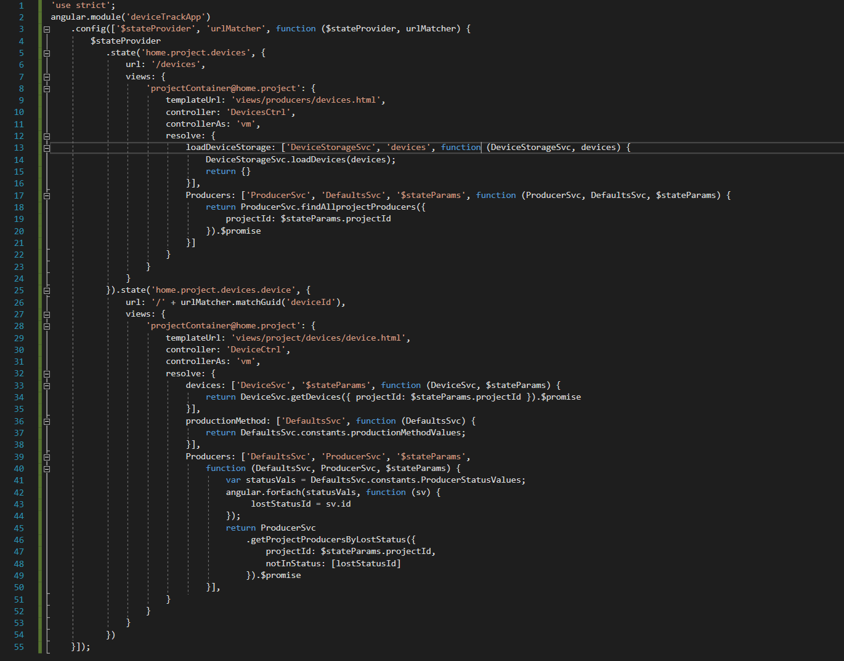
A typical AngularJS SPA route
Module-based Development
State (and URL) Management
Dependency Injection
View Mapping
Controller Activation
Service Resolution

Slide 6
Flip Side
Complexity
Fast rate of change (Angular JS to 2 to 4…)
Tooling and ecosystems still evolving
May be a lot of additional work, costs…
Hey isn’t this supposed to be great for developers? Who’s side are you on? ☺

Slide 7
Let’s Think About Success…
…What matters most is the value delivered to the business; the underlying technology must allow the project to be positioned for it!
Success
Velocity
Features
Velocity
Features
Cost
Cost

Slide 8

Great Microsoft-based Alternatives for Web Development
ASP Forms
Still going strong!
RAD is still relevant
Good designs can be secure and testable.
MVC 5
Also a vibrant ecosystem
Mature Framework
ASP.Net Core:
Open Sourced
Multi-platform
Unified API

Slide 9
Question / Answer

Slide 10
Contact Info:
Lou R. Houlemarde
LouH@Magenic.com
Thank you !

